Slide 1
THIS WEEKS PSLG SESSION (WEEK 10)
HOSTED BY: AMY DREW AND BEN BASTIANELLI

Slide 2


DLSH LINK
IT FOLLOWS MODULE CONTENT!!
JOIN DLSH ITS MEGA FUN YIPPEE!!
MEGA WOWS!!
MUCH FUN!!!

Slide 3
AGENDA
Methods (It’ll be better than last week I promise)
2. Classes (They will also be better than last week I really messed up)

Slide 4
MORE ON METHODS
Quick review on syntax:
Static/
Non Static
Return
Type
Encapsulation
Method Name
Parameters
public static void name (int parameter1, int parameter2)
{
//Your clever code goes here
}

Slide 5
MORE ON METHODS
Quick review on syntax (for return type methods) :
Static/
Non Static
Return
Type
Encapsulation
Method Name
Parameters
public static int name (int parameter1, int parameter2)
{
//Your clever code goes here
return 1;
}

Slide 6
PROBLEM 1
Create a java class called “Wages”.
In this class create a method that calculates the net pay someone gets on a gross wage. This method will have 3 parameters, a value for PRSI, a value for USC and a gross wage
(The values for PRSI and USC don’t have to be accurate but do have to be precents)
This method will calculate the users net pay using these parameters and return that value to the main method where it will be printed out.

Slide 7
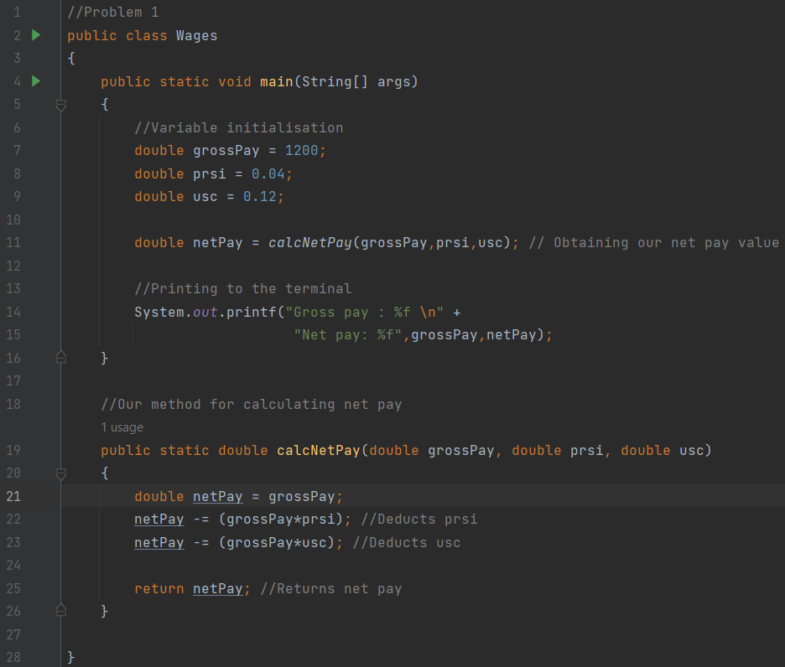
SOLUTION 1

Slide 8
PROBLEM 2
In the same java class that we just worked in, create a method called “to String”.
This method will take 4 parameters, the gross wage, the PRSI, the USC and the net pay obtained from our previous method. This method will return all the data formatted in a string like this:
“Gross pay: 1200
PRSI: 0.04
USC: 0.12
Net pay: 1008”
Tip: String.format(String) can be used to format strings the same way you would with printf.
(Note: when writing a method signature the parameter names are place holders and don’t reference any actual variables in our program until the method is called somewhere in our program.)

Slide 9
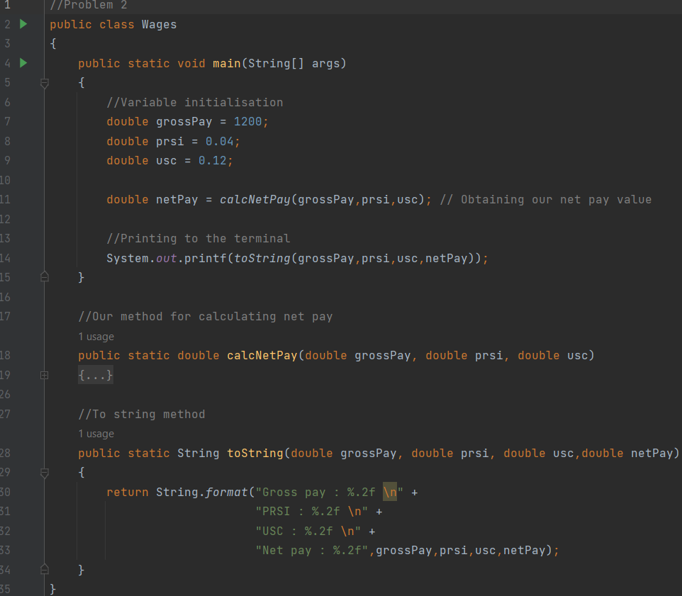
SOLUTION 2

Slide 10
MORE ON CLASSES
Syntax review on Classes: Instantiating an object:
public class Car
{
//Class attributes / global variables
String model;
String colour;
//Constructor
public Name(String num1, String num2)
{
this.model = model;
this.colour = colour;
}
//Methods related to the class
}
public class Car
{
….previous code
//Main method
public static void main (String[], args)
{
String model = “Nissan”;
String colour = “Red”;
//Instantiating the object
Car car = new car(model,colour);
}
}

Slide 11
PROBLEM 3
Modify the class we’ve been working in to have the following changes.
Make PRSI, USC and gross pay class attributes and create a constructor for the class that sets these values based off the parameters passed through.
Modify the methods already made so that they now work with the global variables (Class attributes). This means changing the implementation so that it has no parameters.
Test this by instantiating a wage object in your main method and by calling these methods.

Slide 12
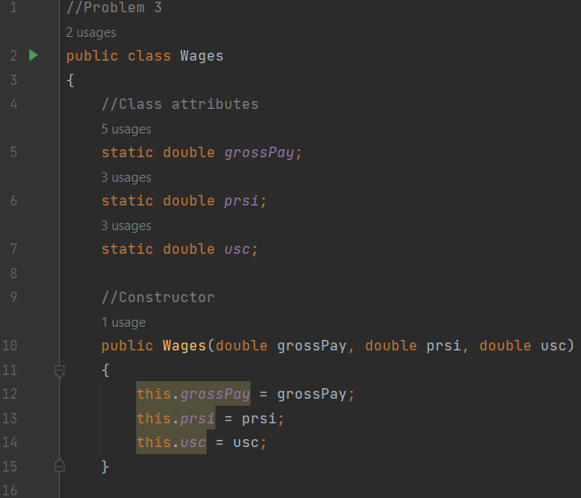
SOLUTION 3 PART 1

Slide 13
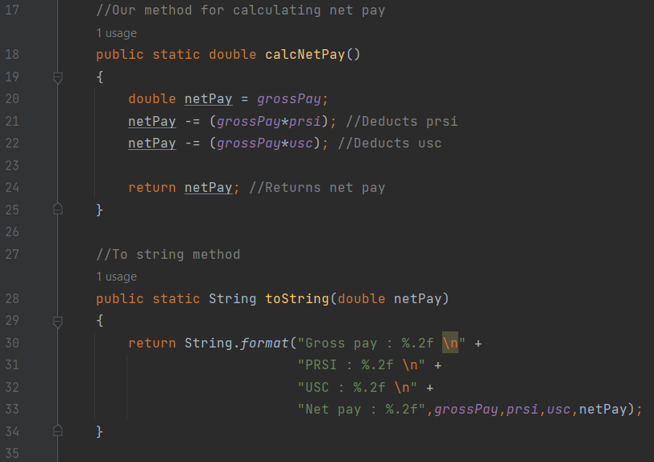
SOLUTION 3 PART 2

Slide 14
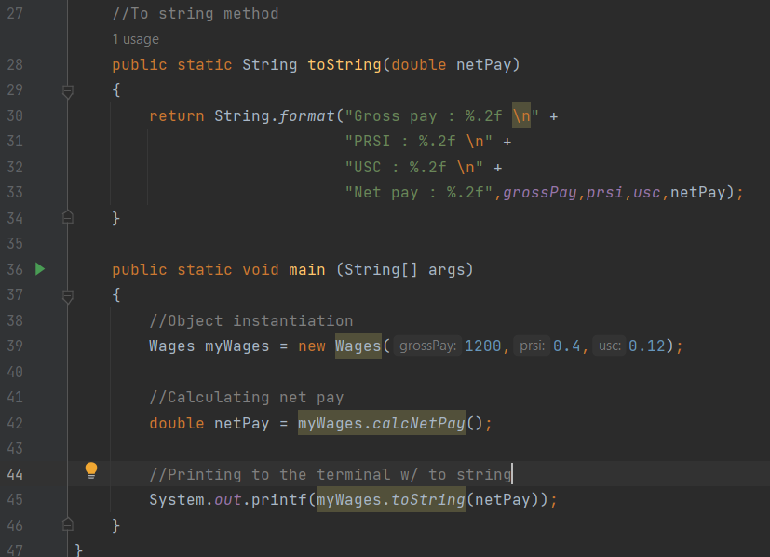
SOLUTION 3 PART 3

